Slide 1
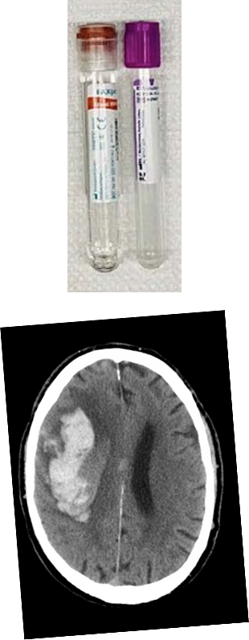
ASPIRE Biobank and Neuroimaging Repository

Slide 2
Objectives
Review the organization and objectives of the ASPIRE Biobank and Neuroimaging Repository
Recruitment status
Ongoing scientific efforts
Useful resources

Slide 3
ASPIRE Biobank and Neuroimaging Repository
Objectives
Maximize scientific impact of ASPIRE by providing infrastructure for ancillary studies that incorporate biosamples and neuroimages
  Scientific questions related to how such data may modify study’s intervention
  Scientific questions related to evaluating these data in setting of ASPIRE as an observational study of ICH outcome and recurrence in patients with atrial fibrillation

Slide 4
Status – Blood samples
Subject Status | Blood Sample Status
Status | Received | Refused | Can’t Obtain* | Pending | Total
NOT TO BE Randomized | 62 | 58 | 31 | 0 | 152
Pending Randomization | 3 | 2 | 0 | 8 | 13
Randomized | 218 | 110 | 30 | 16 | 374
Total | 283 | 170 | 61 | 24 | 539
*Includes 14 subjects consented at 2 sites not participating in Biorepository.
(61%)
(55%)
(33%)

Slide 5
Blood Samples 2022-2024 by Year/Quarter

Slide 6
2 important messages, especially focused on blood samples
1) Please Work on patients that have consented but samples are still pending
2) Please try your best to enroll all patients who consent for the trial

Slide 7
Sites with Subjects Pending Blood Draw
SITE | SUBJECT | SITE | SUBJECT
Ascension St. John | 1542 | Regions Hospital | 1199
Avera Research Institute | 1535 | Rush University | 1400
Cleveland Clinic Akron | 1527 | Stanford University | 1497
Froedtert Hospital | 1525 | Strong Memorial | 1493
Hackensack University | 1533 | Tufts Medical Center | 1500; 1519; 1531
University of Minnesota | 1541 | UC Davis | 1418
Massachusetts General | 1357 | UC Irvine | 1260
MUSC | 1399 | VCU Medical Center | 1393
Mercy San Juan | 1540 | Wake Forest | 1443
Prisma Health Greenville | 1546; 1549 | WellStar Kennestone | 1441
 |  | Westchester Medical Center | 1476

Slide 8
Tips for Consenting for Blood Biobank
Separate consent but STRONGLY ENCOURAGED
One-time blood draw – Can obtain any time after consent
Small marginal effort with substantial added scientific value
Possible introduction
  “By participating in this parallel study, you have an opportunity to contribute a one-time blood sample for future research. This may help the study team and other researchers understand more about brain hemorrhage and stroke and we’d be very grateful.”

Slide 9
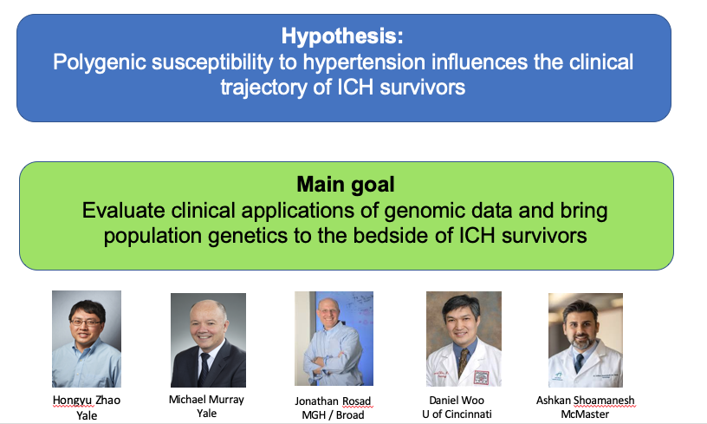
Example: Ongoing Ancillary Study
Polygenic Susceptibility to Hypertension in ICH:
from Population Studies to Precision Medicine at the Bedside
IMPORTANT
This is an example to illustrate to potential uses of the ASPIRE Biobank. This information should NOT be used during the consent process (e.g., study participants should not consent for this particular ancillary study, they should consent for the ASPIRE Biobank in general)

Slide 10
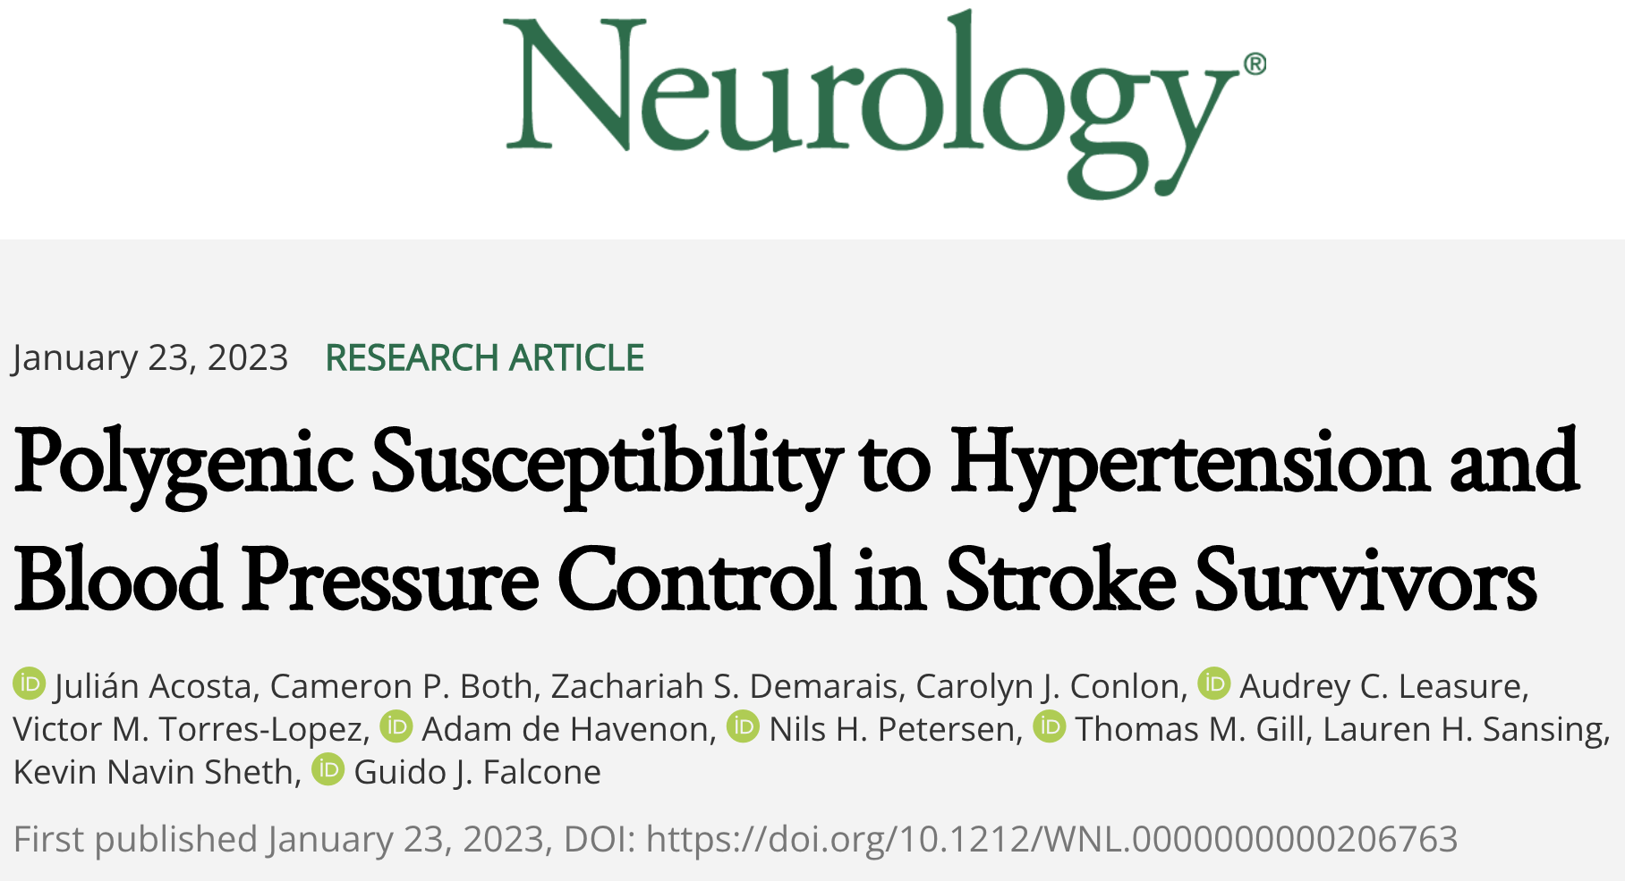
Example: Ongoing Ancillary Study
Polygenic Susceptibility to Hypertension in ICH:
from Population Studies to Precision Medicine at the Bedside

Slide 11
Methods
Study design
- Nested cross-sectional study using data from the UK Biobank
Participants
- Patients with a prevalent ischemic or hemorrhagic stroke at enrollment
Exposures
- Polygenic susceptibility to hypertension
Polygenic risk score comprising 732 genetic variants associated with SBP levels
Categorized in quintiles of this polygenic risk score (from very low to very high genetic risk)
Outcome
- Systolic blood pressure (SBP) levels
- Uncontrolled hypertension (UHTN): SBP > 140 mmHg or DBP > 90 mmHg
- Resistant hypertension (RHTN): UHTN despite taking 3 or more BP-lowering medications.

Slide 12
Baseline characteristics
Variable | Ischemic and Hemorrhagic Stroke Survivors (n = 6,294) Quintiles of Polygenic Susceptibility to Hypertension
 | Very low | Low | Intermediate | High | Very high | p value
Age | 60.69 (6.73) | 60.54 (6.94) | 60.85 (6.51) | 60.71 (6.88) | 60.94 (6.55) | 0.617
Female Sex | 513 (40.7) | 524 (41.6) | 522 (41.5) | 512 (40.7) | 504 (40.1) | 0.933
HTN | 519 (41.2) | 654 (51.9) | 716 (56.9) | 765 (60.8) | 879 (69.9) | <0.001
DM | 152 (12.1) | 155 (12.3) | 175 (13.9) | 168 (13.3) | 182 (14.5) | 0.333
HLD | 410 (32.6) | 436 (34.6) | 425 (33.8) | 409 (32.5) | 445 (35.4) | 0.462
Ever smoker | 533 (42.8) | 511 (40.7) | 582 (46.6) | 544 (43.5) | 569 (45.6) | 0.068

Slide 13
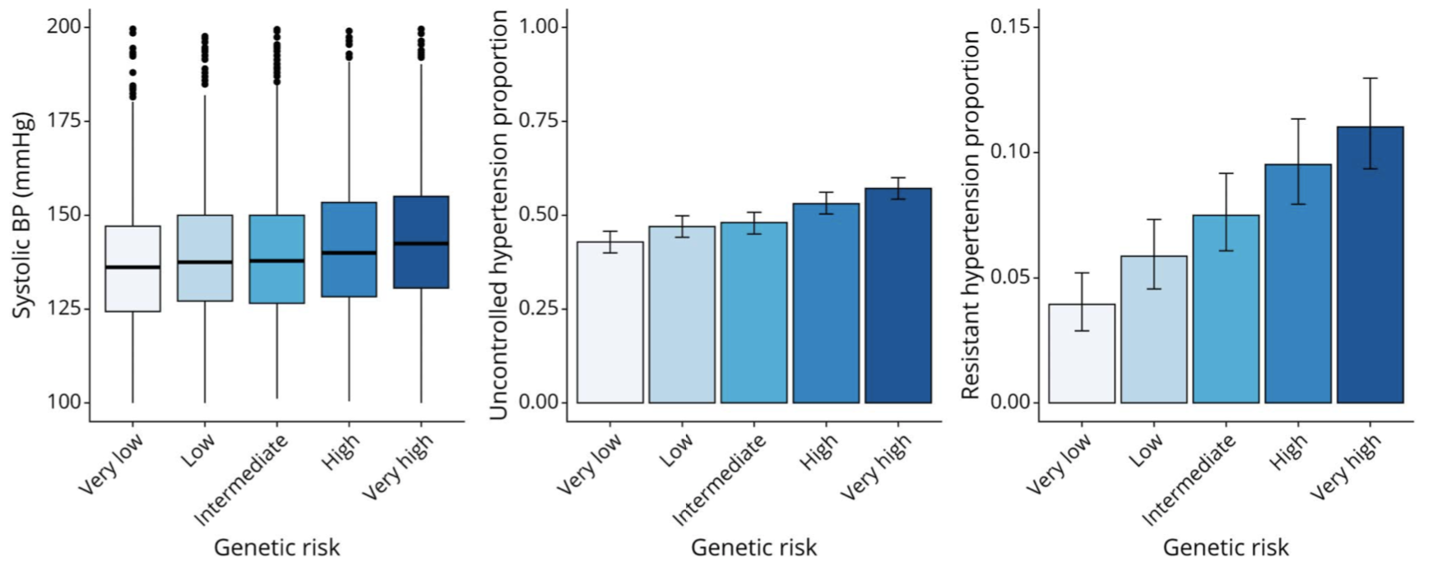
Systolic BP, uncontrolled hypertension and resistant hypertension in 984 hemorrhagic stroke survivors across quintiles of a blood pressure-related PRS
Systolic blood pressure
Uncontrolled hypertension
Resistant hypertension
Acosta et al. Neurology. 2023 Jan 23;10. Epub ahead of print

Slide 14
Conclusions
In hemorrhagic stroke survivors, PSH is associated with higher observed BP, risk of uncontrolled blood pressure, risk of resistant hypertension.
These findings remain significant in hemorrhagic stroke survivors.
PSH based precision medicine strategies could help identify patients that would benefit from aggressive diagnostic or therapeutic approaches.

Slide 15
Neuroimaging Repository
Collection of neuroimages from all randomized participants
Neuroimages used to:
  Support work of adjudicators
  Conduct secondary analyses based on central adjudication
  Conduct ancillary studies
Researchers should complete any locally required additional training needed for identification, storage and uploading of neuroimages

Slide 16
Neuroimages To Be Submitted
Baseline Event – Please submit w/in 14 days of randomization
  First brain CT scan for index ICH
  If obtained,
    One follow-up brain CT scan after initial imaging
    One vascular study (CTA/MRA obtained during hospitalization for index ICH)
    First brain MRI following index ICH – up to day 90 post index ICH
Post-randomization Stroke/Brain Trauma events – Please submit ASAP
  Same studies as above (except MRI only during hospitalization)

Slide 17
Neuroimaging Repository Status for Index Event
(n=374 subjects)
Type of Study | Study Status |  |  | In Repository (if done)
Study | ? | Not Done* | Done | Study in Repository
Index CT | 16 | 4 | 354 | 327 | (92%)
Follow-up CT | 30 | 43 | 301 | 282 | (93%)
MRI | 20 | 117 | 237 | 227 | (96%)
CTA or MRA | 16 | 64 | 294 | 272 | (93%)
*Not done or available.

Slide 18
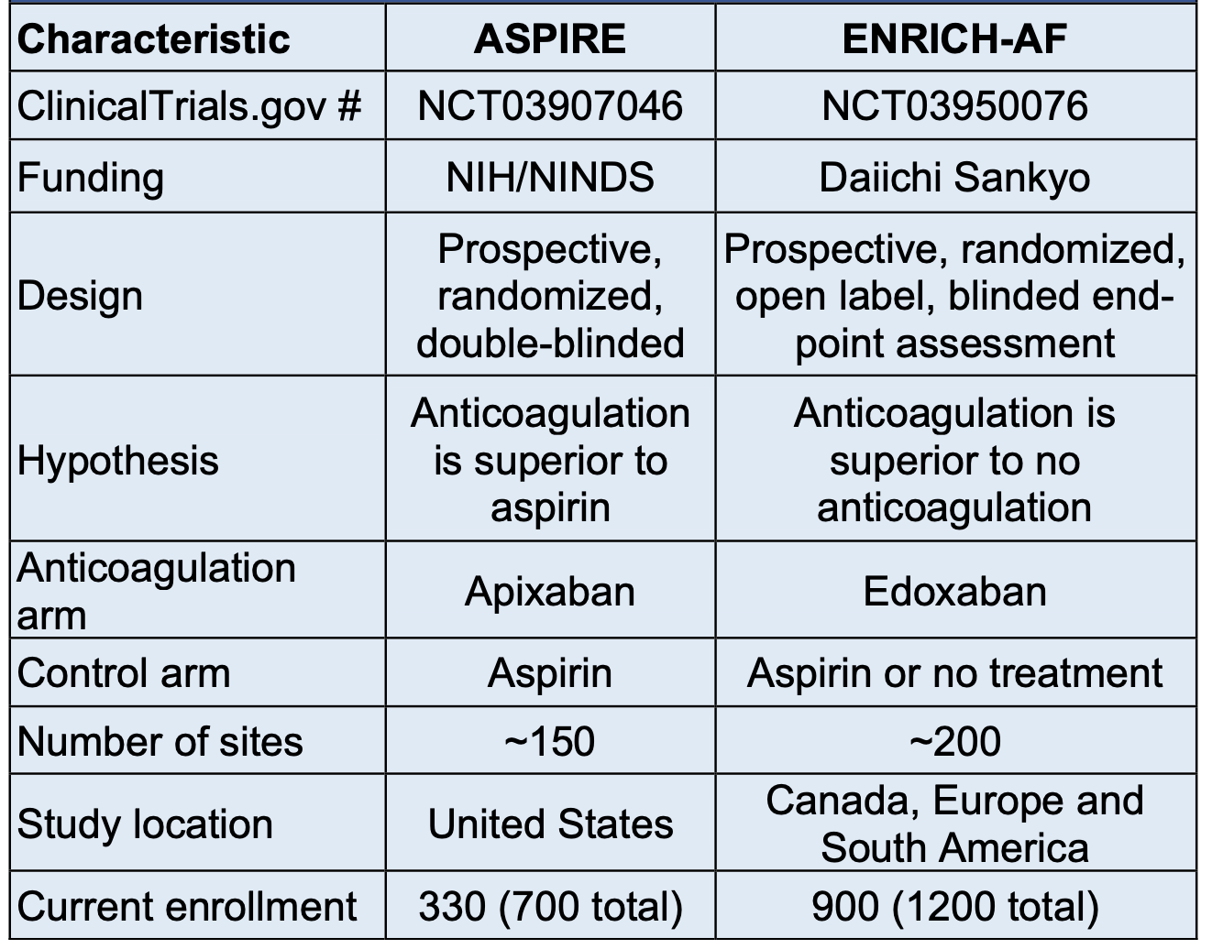
Proposal under review
Anticoagulation in Intracerebral Hemorrhage Survivors with Atrial Fibrillation and Imaging features of Cerebral Amyloid Angiopathy and Small Vessel Disease

Slide 19
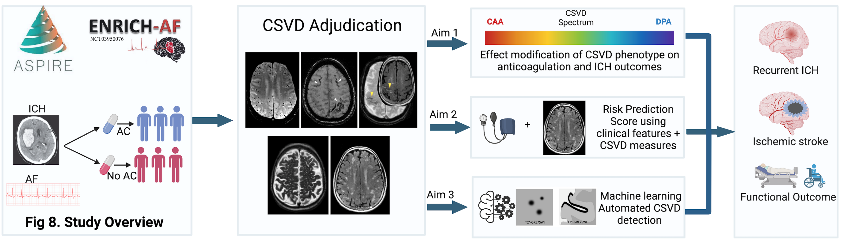
Proposal under review
Anticoagulation in Intracerebral Hemorrhage Survivors with Atrial Fibrillation and Imaging features of Cerebral Amyloid Angiopathy and Small Vessel Disease

Slide 20

Summary
The ASPIRE Biobank and Neuroimaging Repository is an integral part of the ASPIRE Study.
Coupled with the high-quality clinical data produced by the study, the biosamples and neuroimages can lead to substantial scientific contributions.
It is crucial to convey these ideas during the consent process to achieve the goal of obtaining blood samples and neuroimages from ALL study participants.
One important idea: aside from the one-time blood draw, participating in the biobank does not generate ANY additional burden to study participants.

Slide 21
2 important messages focused on blood samples
1) Please Work on patients that have consented but samples are still pending
2) Please try your best to enroll all patients who consent for the trial

Slide 22
The ASPIRE BIOBANK team is here to help!
Guido Falcone
Mobile 857-265-5255
guido.falcone@yale.edu
Lauren Sansing
Mobile 860-841-8145
lauren.sansing@yale.edu

Slide 23
Thanks!

