Slide 1

Coordinator Webinar and Round Table Discussion
August 22, 2018

Slide 2
Coordinator Call
Announcements and Reminders
Next Coordinator Webinar :
Next Coordinator Call September 26th, 2018.
Today’s Roundtable Hosts: Kayla Gosselin, Joelle Sickler and Devin Brown MD.
To join Coordinator Webinars: https://nihstrokenet.adobeconnect.com/coordinator/ Please enter as a guest, then add your first and last name or email address. For Audio: Dial-In Number: (877) 621-0220 Passcode 434578.
Upcoming StrokeNet Meetings:
Plan Ahead: Montreal World Stroke Conference, October 16th, 2018.
NCC will reimburse for one night stay at $250.

Slide 3
Project Updates
TELE-REHAB
Closed to Enrollment:
Study Updates:
Study Project Managers: Lucy Dodakian, MA, OTR/L
Judith Spilker, RN, BSN
Study Investigator: Steve Cramer, MD
Data Manager: Kavita Patel

Slide 4
Project Updates i-DEF
Closed to Enrollment:
Study Updates:
Study Project Manager: Jessica Griffin
Study Investigator: Magdy Selim, MD

Slide 5
Project Updates
DEFUSE 3
Closed to Enrollment:
Study Updates:
Study Project Manager: Stephanie Kemp, BS
Janice Carrozzella, MSN, CNP, RT(R), CCRA
Study Investigator: Greg Albers, MD
Data Manager: Jessica Griffin

Slide 6
Project Updates
CREST 2
Study Updates:
Study Project Manager: Mary Longbottom, CCRP, CREST Director for Data Quality
Study Investigator: Tom Brott, MD

Slide 7
Project Updates
ARCADIA
Study Updates:
Study Project Manager: Irene Ewing, RN, BSN
Study Investigator: Hooman Kamel, MD;
Mitch Elkind, MD
Data Manager’s: Faria Khattak, Holly Pierce,
Jocelyn Anderson

Slide 8
ARCADIA Enrollment and start-up
Total Number of Subjects enrolled/consented (as of 8/21): 247
Percent Eligible for Randomization: 41%
Total Randomizations: 68/1100
100 Sites have CIRB approval for ARCADIA
86 Readiness Calls completed
VA sites- 6 out of 7 have been submitted to VA CIRB

Slide 9
Site Activity
61 Sites have consented at least one subject
Of the 39 Sites that have not consented any subjects:
2 sites released in April
7 sites released in May
4 sites released in June
Please reach out to your sites to see if they need assistance.
The ARCADIA PIs or the NCC team will make phone calls if this will help.

Slide 10
Core Lab reminders and Updates
Lab specimens sent in recently without being labeled
Please remind coordinators about this!
New lab kits shipping module is being created in WebDCU-more details will be shared next week on the webinar.

Slide 11
Reminders and updates
Monthly ARCADIA webinar next Tuesday at 2pm ET!
Weekly Email updates from the ARCADIA PIs
Newsletter is going out bi-weekly from Daniel Velez
If you think one of your sites might need a refresher training reach out to me.

Slide 12
Project Updates
Sleep Smart
Sleep Smart PI: Devin Brown MD
Project Manager’s: Kayla Gosselin
Joelle, Sickler
Sleep SMART Data Manager’s: Faria Khattak and
Jocelyn Anderson

Slide 13




Slide 14

MOST Study Team
Principal Investigators
  (Lead) Opeolu Adeoye, MD, MS, University of Cincinnati
  Andrew Barreto, MD, MS, University of Texas-Houston
  Jim Grotta, MD, Memorial Hermann Hospital-Texas Medical Center, Houston
  Joe Broderick, MD, University of Cincinnati
  Colin Derdeyn, MD, University of Iowa
University of Cincinnati Clinical Coordinating Center
  S. Iris Deeds, CCRP – Lead Trial Coordinator (deedsss@ucmail.uc.edu)
NIH StrokeNet National Coordinating Center
  Teresa Murrell-Bohn, RN, CCRC – NCC MOST Project Manager (murreltm@ucmail.uc.edu)

Slide 15
MOST Projected Timeline
    Mid-November, 2018
      Plan to resubmit to FDA following completion of IP (Investigational Product) stability testing
    Mid-December, 2018 –
      Plan is to submit to CIRB (Amendment 1)
      Targeting January, 2019, for CIRB approval of Amendment 1
    Early-mid January, 2019
      MOST Protocol Training Webinars to begin
    End of January, 2019
      Emails to start going out with CIRB Study Start-Up Packets
  Thank you. More in the coming weeks/months…

Slide 16
NCC Regulatory Specialist
Emily Stinson
estinsoney@ucmail.uc.edu
Investigator Information Form
      Contact information for the startup packet
      Legal name/address of the research site and any other location where study activities will take place
      Primary study team
      Pharmacy information and drug shipment address
      Other study specific information, as needed
    Startup Email
      Study specific training instructions
      PI signature documents
      CIRB documents, consent, financial disclosure document(s)
      Other study specific documents
    Please begin collecting the required study documents. Have investigators update CV’s and become familiar with local IRB acknowledgement process and timelines.

Slide 17
Project Updates
Recognized NIH Trials
That remain open to enrollments:
Study Updates:
SHINE
Project Manager: Heather Haughey

Slide 18
NCC/NINDS Updates
NCC Staff Members:
Joe Broderick, PI
Jamey Frasure, Co-Director Judith Spilker, Co-Director
Sue Roll, CIRB Liaison Keeley Hendrix, CIRB
Diane Sparks, Contracts Jeanne Sester, Training Coordinator
Mary Ann Harty, Finances Rose Beckmann, Administration
Joanna Vivalda, NINDS Scott Janis, NINDS

Slide 19
Data Management Center Updates
WebDCU/MUSC Team:
Yuko Palesch, PI Wenle Zhao, PI
Catherine Dillon, Operations Mgr.
Jessica Griffin, Project Mgr.

Slide 20
CIRB Updates
CIRB Team Members:
Sue Roll, CIRB Liaison
Keeley Hendrix CIRB Coordinator
Jo Ann Behrle CIRB HPA

Slide 21
Roundtable Discussion
Today’s Roundtable Discussion:
Sleep Smart Study
Today’s Hosts:
Kayla Gosselin: Study Project Manager
Joelle Sickler: Study Project Manager
Devin Brown MD: Sleep Smart PI

Slide 22


Sleep for Stroke Management And Recovery Trial

Slide 23
Study Team
Principal Investigators
Devin Brown, MD, MS, University of Michigan
Ronald Chervin, MD, MS, University of Michigan
Prime Project Manager
Kayla Gosselin, MPH, CCRP, University of Michigan
NCC Project Manager
Joelle Sickler, MSN, RN, CCRC, CCRA, University of Cincinnati

Slide 24
Study Team
Telemedicine partner: Jeff Durmer (FusionHealth, Chief Medical Officer), Helgi Helgason (Director of Clinical Operations)
Lewis Morgenstern (Co-I)
Consultants: Craig Anderson, Dawn Bravata, and Klar Yaggi
NCC: Jamey Frasure, Mary Ann Harty, Diane Sparks, Emily Stinson
NDMC: Jessica Griffin, Catherine Dillon, Faria Khattak, Ellen Underwood, Jocelyn Anderson
NINDS: Claudia Moy, Joanna Vivalda, Scott Janis
Key roles:
Project PIs: Devin Brown, Ronald Chervin
StrokeNet National Data Management Center (NDMC) Project PI: Valerie Durkalski
StrokeNet National Coordinating Center (NCC) PI: Joseph Broderick
StrokeNet NDMC PI: Yuko Palesch
Event Adjudicators: Darin Zahuranec, Deborah Levine

Slide 25
Study Team
Principal Investigators
Devin Brown, MD, MS, University of Michigan
Ronald Chervin, MD, MS, University of Michigan
Prime Project Manager
Kayla Gosselin, MPH, CCRP, University of Michigan
NCC Project Manager
Joelle Sickler, MSN, RN, CCRC, CCRA, University of Cincinnati

Slide 26
Background
Post-stroke/TIA sleep apnea prevalence ~75%
Risk factor for incident and recurrent stroke, post-stroke deaths, and poor functional outcome after stroke
Attractive target for intervention, especially given that its treatment is very low risk

Slide 27
Background
Observational studies have shown much better outcomes for sleep apnea patients who use their CPAP
Multiple pilot trials including our own have laid the foundation for a definitive trial

Slide 28
AHA secondary prevention guidelines 2014
“Given these generally promising albeit mixed results across the randomized trials and the observational cohort studies, what is clearly needed is a randomized trial with adequate sample size to examine whether and the extent to which treatment of sleep apnea with CPAP improves outcomes such as stroke severity, functional status, and recurrent vascular events.”

Slide 29
Study Synopsis
Investigator-initiated, phase 3 multicenter, prospective randomized open-, blinded-endpoint (PROBE) controlled trial
110 sites nationwide
~3000 subjects randomized, 15,000 subjects screened
Enrollment over 4 years

Slide 30
Objectives and Primary Endpoints
Objectives: Determine whether treatment of obstructive sleep apnea (OSA) with positive airway pressure started shortly after acute ischemic stroke or high risk TIA (1) reduces recurrent stroke, acute coronary syndrome, and all-cause mortality 6 months after the event, and (2) improves stroke outcomes at 3 months in patients who experienced an ischemic stroke.
Primary Endpoints: (1) Prevention endpoint: the composite outcome of recurrent stroke, acute coronary syndrome, or all-cause mortality at 6 months, (2) Recovery endpoint: functional outcome at 3 months.
Secondary Endpoints: neurological, cognitive, and quality of life outcomes at 3 months.

Slide 31
Study Population
Inclusion: Inpatient at an enrolling site, ≥ 18 years old, who has had an ischemic stroke, or TIA with ABCD²≥4, within the prior 14 days. Participant duration is 6 months.

Slide 32
Exclusion Criteria
Pre-event inability to perform all of own basic ADLs
Unable to obtain informed consent from subject or legally authorized representative
Incarcerated
Known pregnancy
Current mechanical ventilation (can enroll later if this resolves) or tracheostomy
Current use of positive airway pressure, or use within one month prior to stroke
Anatomical or dermatologic anomaly that makes use of CPAP interface unfeasible
Severe bullous lung disease
History of prior spontaneous pneumothorax or current pneumothorax
Hypotension requiring current treatment with pressors (can enroll later if this resolves)
Other specific medical circumstances that conceivably, in the opinion of the site PI, could render the patient at risk of harm from use of CPAP
Massive epistaxis or previous history of massive epistaxis
Cranial surgery or head trauma within the past 6 months, with known or possible CSF leak or pneumocephalus
Recent hemicraniectomy or suboccipital craniectomy (i.e. those whose bone has not yet been replaced), or any other recent bone removal procedure for relief of intracranial pressure

Slide 33
Study Intervention
Intervention: Autoadjusting continuous positive airway pressure (aCPAP) delivered with the ResMed Airsense 10 autoset.
Control: Usual care.

Slide 34
Protocol Flow
Notes:
Go through enrollment process here

Slide 35

Telemedicine
Partnering with a sleep health company, Fusion Health
Leverage technology to provide state-of-the-art telemedicine care to our subjects
aCPAP remotely monitored
Care manager
  technology team
  respiratory therapy team
  sleep medicine physicians

Slide 36
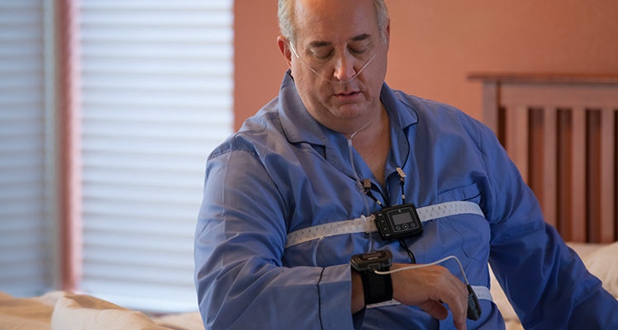
Nox T3

Slide 37
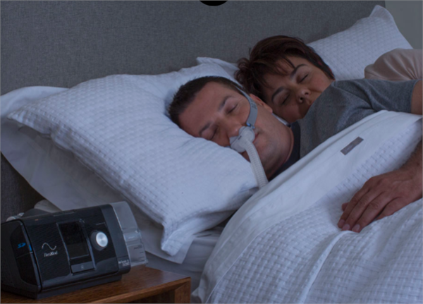
ResMed AirSense 10

Slide 38
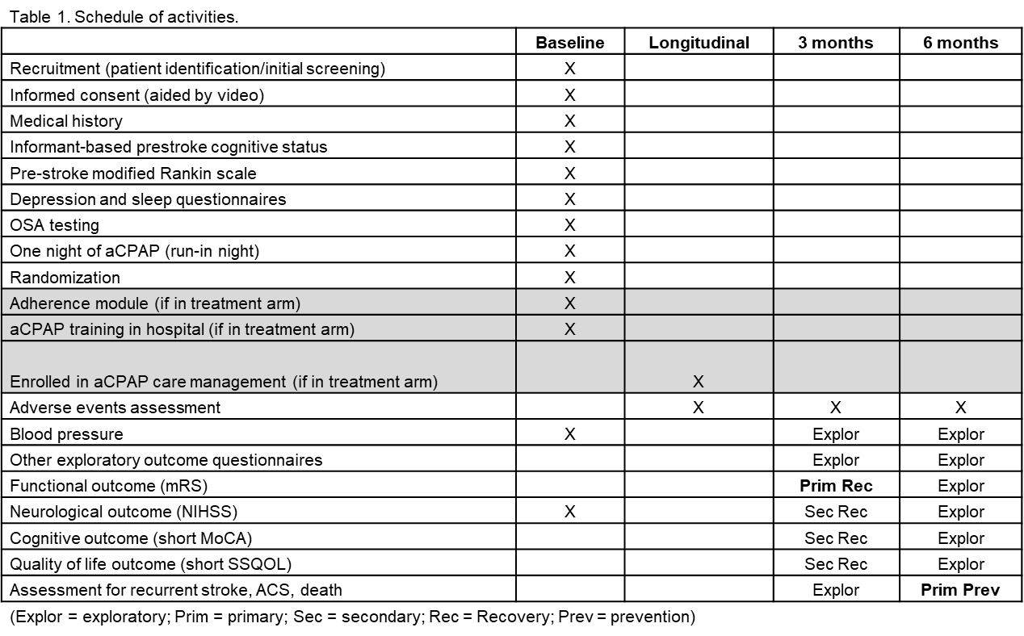
Schedule of Activities

Slide 39
Anticipated Challenges
Recruitment
Adherence to aCPAP

Slide 40
Next Steps
Notice of Award (dated 8/15/18)
Site Selection
Start-Up (contracts)
Investigator Meeting
Anticipate first patient 6 months after NoA is received

Slide 41
Questions?
Please free to contact us at any time!
Kayla Gosselin (UM)
kcgossel@med.umich.edu
Joelle Sickler (NCC)
sicklejb@ucmail.uc.edu

Slide 42
General Information and Reminders
Agenda items for Montreal Meeting.
Presenters for upcoming Meetings/Coordinators Calls.
Confirmed Montreal Managers Breakout Session
Meet and Greet the evening before the meeting (time and place TBD).
RPPR reports due
Review sites FWA for expiration dates and name changes.
MTA and RA amendments coming soon.

