Slide 1

Perinatal Arterial Stroke (PAS):
A Phase III Multi-site Trial of I-ACQUIRE
First Investigators Meeting
Protocol Overview
1 May, 2019
Sharon Landesman Ramey, Ph.D. (Lead PI)
Fralin Biomedical Research Institute (FBRI), Virginia Tech (Roanoke)
Warren Lo, M.D. (Co-PI)
Nationwide Children’s Hospital & The Ohio State University (OSU)

Slide 2
Perinatal Arterial Stroke (PAS):
A Phase III Multi-site Trial of I-ACQUIRE
Sharon Landesman Ramey, Ph.D. (Lead PI)
Fralin Biomedical Research Institute (FBRI), Virginia Tech (Roanoke)
Warren Lo, M.D. (Co-PI)
Nationwide Children’s Hospital & The Ohio State University (OSU)
Stephanie DeLuca, Ph.D. & Craig Ramey, Ph.D.
Treatment Implementation Center Directors, FBRI, Virginia Tech (Roanoke)
Amy Darragh, Ph.D., OTR/L & Jill Heathcock, Ph.D., MPT
Central Assessment Center Directors, OSU
Max Wintermark, M.D.
Clinical MRI Center Director, Stanford University
Laura Bateman
National Study Coordinator, FBRI, Virginia Tech

Slide 3
The primary locations of the 12 I-ACQUIRE Sites
Ann Arbor Atlanta
Baltimore Boston
Chicago Cincinnati
Columbus Houston
New Haven Philadelphia
Roanoke San Diego

Slide 4
Stroke in Infants and
Current Treatment Approaches
Pediatric arterial ischemic stroke occurs most frequently in infants
  Incidence of Neonatal Arterial Ischemic Stroke (NAIS) is 1:2500 – 1:7700 live births
  Incidence of presumed prenatal/perinatal stroke similar to NAIS (diagnosed at later ages after neuromotor impairment detected) COMBINED INCIDENCE = 1:1250
No consensus rehabilitation for infants with post-stroke hemiplegia
  Wide array of intervention approaches
    Weekly low-dose OT and/or PT therapy is typical (not evidence-based)
    Consensus from systematic reviews that constraint-induced movement therapy (CIMT) is the most efficacious treatment for children with hemiparesis
      CIMT is considered high-intensity and actively shapes voluntary control
  No adequately powered RCT of CIMT in infants/toddlers (< 24 mos)
  No RCT of signature CIMT focused on infants/toddlers after stroke
  I-ACQUIRE IS A SIGNATURE FORM OF CIMT TESTED IN MULTIPLE RCTs

Slide 6
I-ACQUIRE Phase III Trial Specific Aims
Primary Aim: Determine the efficacy of I-ACQUIRE at 2 dosage levels compared to usual and customary treatment (U&CT) to increase upper extremity skills on the hemiparetic side at both end of treatment and 6 mos post-treatment
Secondary Aim: Determine the efficacy of I-ACQUIRE at 2 dosage levels compared to U&CT to improve use of the hemiparetic upper extremity in bimanual activities at both end of treatment and 6 mos post-treatment
Exploratory Aim: Explore the association between I-ACQUIRE treatment at Moderate and High Doses and gains in gross motor, language, and cognition outcomes (i.e., cross-domain or “spillover” effects of treatment)

Slide 7
Public Health Impact of
I-ACQUIRE Phase III Trial
Estimated 3400+ new cases/yr of Perinatal Arterial Stroke (PAS) in U.S.
High likelihood of lifelong motor and cognitive impairments, especially hemiparesis
Immense cost burden for families, the healthcare and education systems, and society
If I-ACQUIRE (at one or both doses) proves efficacious,
then the field will have the critically needed Phase III
confirmatory evidence to transform evidence-based rehabilitation and improve clinical outcomes for infants and toddlers with PAS.

Slide 8
DESIGN FOR PHASE III I-ACQUIRE TRIAL
Eligibility Screening and Enrollment (N=240)
Perinatal Arterial Stroke (PAS) diagnosis
with confirmatory MRI & hemiparesis (8–24 mos)
Random Assignment (centralized) to
I-ACQUIRE DOSAGE GROUPS or U&CT
Moderate Dose
I-ACQUIRE (N=80)
3 hr/day x 20
High Dose
I-ACQUIRE (N=80)
6 hr/day x 20
Usual & Customary Tx (U&CT) (N=80)
documented
Baseline (pre-treatment) Assessment Battery
Blinded Assessments (videorecorded) & Parent Ratings
Implementation of Treatment Protocol (4 weeks)
Active Central Monitoring, Weekly Videorecording, & Therapy Logs
Post-treatment Assessment Batteries: Immediate & 6 mos.
Blinded Assessments (videorecorded) & Parent Ratings
U&CT Parents offered choice of
I-ACQUIRE Dosage (Crossover)

Slide 9
Inclusion/Exclusion Criteria for
I-ACQUIRE Phase III Trial
Inclusion criteria
  8-24 mos old at time when treatment delivered
  Perinatal Arterial Ischemic Stroke (PAS) diagnosed
  PAS confirmed with clinical MRI (high-quality, standardized)
  Hemiparesis
  Parents able to participate in home-based intervention
    present at least 1 day/wk for therapy and 45 min/day practice at home
    Exclusion Criteria
      Fragile medical health
      Prior receipt of CIMT ≥ 2 hrs/day x 10 days
      Botox within past 3 mos
In prior studies of ACQUIRE, parent willingness to enroll is high (93-95%) and attrition rate is low (5-7%). Option of crossover (delayed) treatment is important.

Slide 10
8 Core Treatment Components
(bold font represents core features of all signature forms of CIMT)
Constraint of the less-impaired upper extremity for first 17 days of 20 treatment days. The lightweight cast is worn continuously.
High (intensive) dosage of treatment – either 3 or 6 hrs/day, 5 days/wk for 4 weeks – provided by protocol-trained OTs or PTs (licensed, certified)
Operant conditioning techniques to shape and improve skills and abilities, combined with practice variation; emphasis on play, self-help, fun, and use of a variety of individualized reinforcers
Therapy in natural settings (e.g., home, child care center)
Shaping includes total body/trunk and bimanual activities (as well as traditional arm/hand therapy activities)
Parent-Therapist Partnership (formal module) all 4 weeks
Daily therapy sessions documented
Transfer Package to promote future skill and motor development

Slide 11
Save these 2019 dates: Upcoming I-ACQUIRE events
Thursday, 18 April 2019 from 2:00 – 3:00 p.m.: Webinar about the Clinical Trial Agreement (CTA) and Payment Schedule (U of Cincinnati)
Thursday, 25 April 2019 from 2:00 – 3:00 p.m.: Webinar about the Central Institutional review Board (CIRB) Process and Local Site Compliance (U of Cincinnati)
Tuesday, 30 April 2019 in Chicago/Hilton Chicago O-Hare Airport (7:00 – 8:30 p.m.): Evening reception for I-ACQUIRE Study team and local site PIs, Co-Is, and Study Coordinators
Wednesday, 1 May 2019 in Chicago/Chicago O-Hare Airport (8:30 a.m. – 4:00 p.m.): First Meeting of Local Sites and I-ACQUIRE national team
Sunday, 16 June 2019 – Monday, 17 June 2019: First meeting of Parent Council in Roanoke
Monday, 17 June 2019 (evening orientation) in Roanoke – Friday, 21 June: Required training for I-ACQUIRE therapists
Mid-June to mid-July 2019: Required training (webinars and calls) for assessors
1 August 2019: Open to consent, randomize, schedule, and implement assessments and treatments

Slide 12
Some unique aspects of I-ACQUIRE in StrokeNet
First pediatric trial in StrokeNet
First trial to engage patient advocates (parents) in the trial through a Parent Council
Designed to set the stage for Implementation Research. Important because I-ACQUIRE protocol is complex, intensive, and requires training to ensure high fidelity – thus challenging traditional clinical treatment of this patient population.
Well-suited to advancing knowledge about differential responses to treatment and theories re: neuroplasticity in young children after stroke, including potential biomarkers for individualizing treatment choices.
Explicit shared goal to begin to create an even stronger multidisciplinary network of pediatric neurology and rehabilitation scientists – to exchange ideas and propose other studies in the near future.

Slide 13

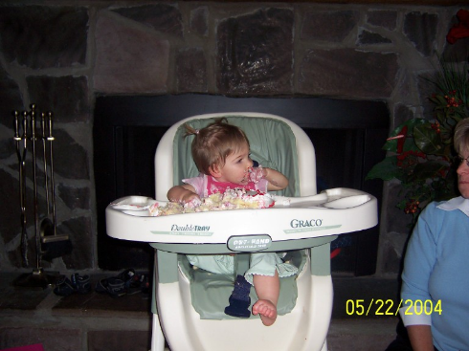
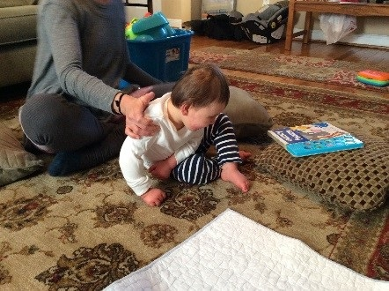
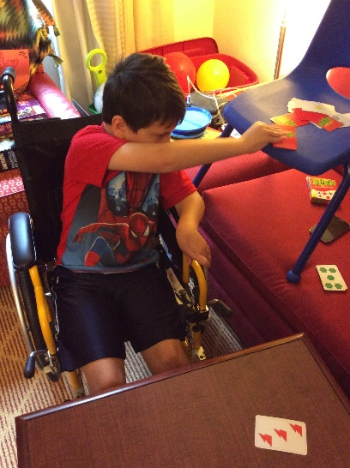

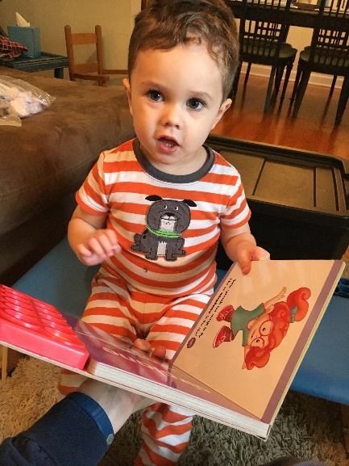
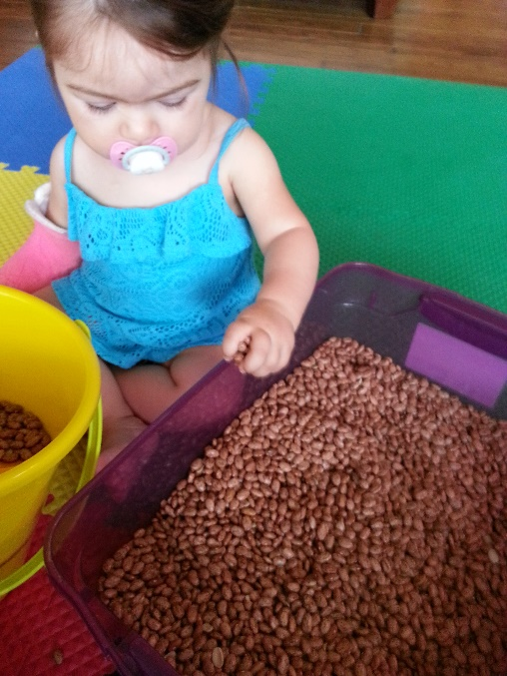

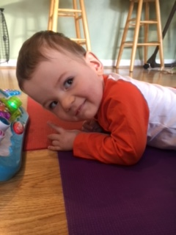
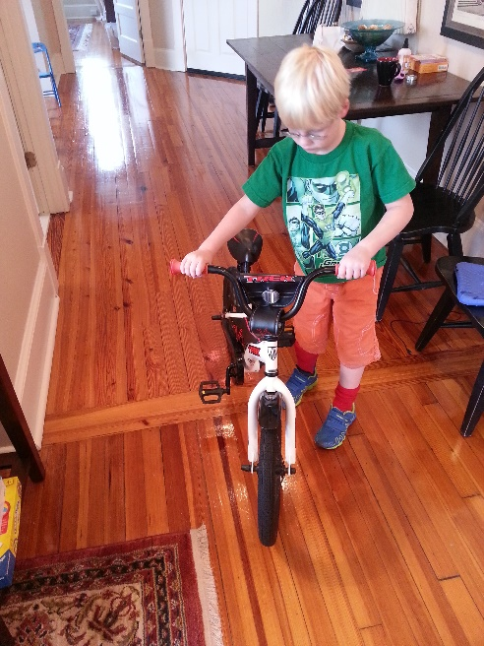
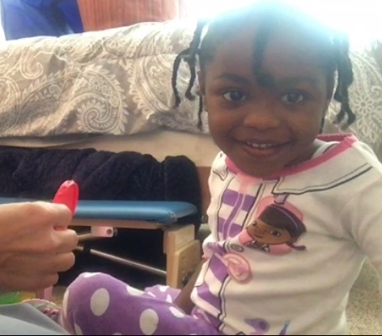
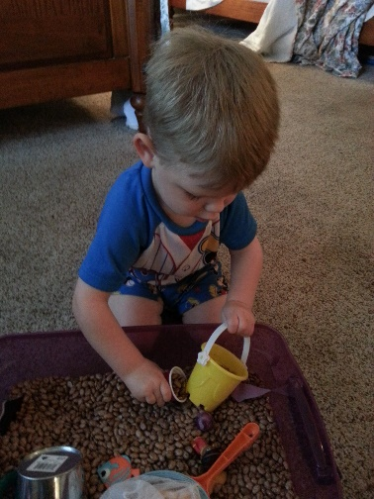
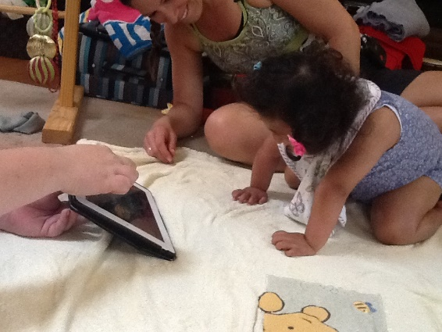
Stephanie C. DeLuca, PhD
NEUROMOTOR RESEARCH CLINIC
Notes:
So you have many models out there
Including us
We had countless parents tell us our version is just different enough.
Do we need to better operationalize? Yes
But our clinic also allowed us to continue our science

Slide 14
The EIGHT
I-ACQUIRE
Treatment Components

Slide 15
Video of Weekly Progress of Infant over 4 week treatment

Slide 16
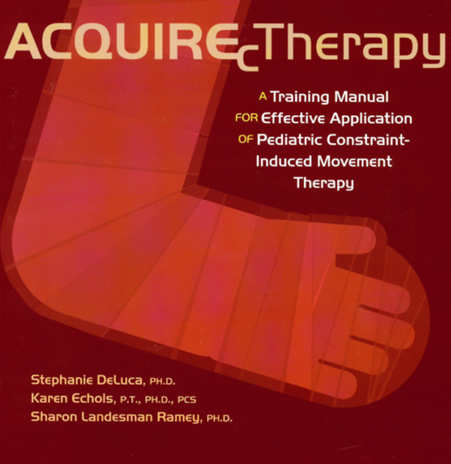
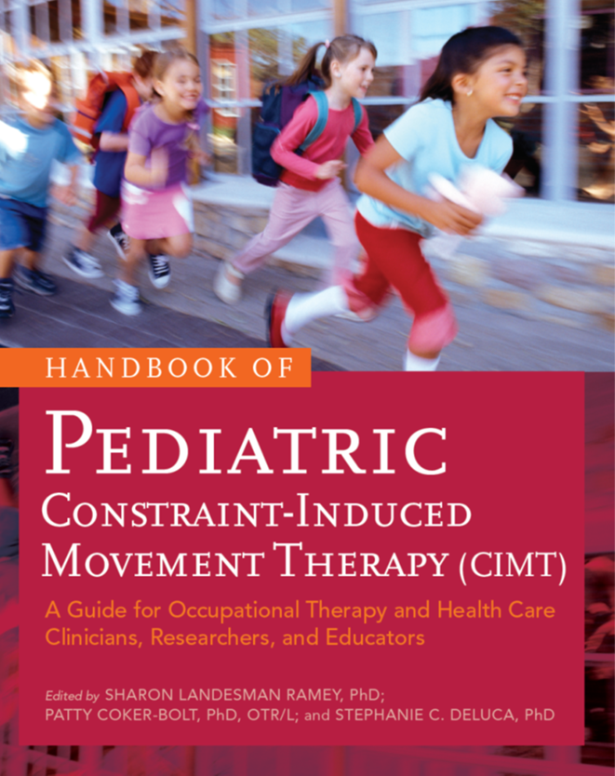

Slide 17

Five Essential Components of P–CIMT | *Signature or Traditional P–CIMT | Modified P–CIMT
1. Constraint of the less or unimpaired upper extremity | Constraint of the less or unimpaired upper extremity for majority of waking hours and during active treatment | Constraint of the less or unimpaired upper extremity at least during active treatment
2. High dosage (likely minimum threshold: 2-hr sessions per day for 5 days/wk) | High dosage of therapy in a concentrated period of time involving active treatment for a minimum of 3 hrs/day for 5 days/wk for multiple weeks | High dosage of therapy in a concentrated period of time with a minimum of 2 hrs/day for 5 days/wk for multiple weeks
3. Use of shaping techniques and repetitive practice with task variation | Use of shaping techniques to review, extend, practice, and refine skills that use formal operant learning techniques with immediate feedback and reinforcement in all treatment sessions | Use of shaping techniques to review, extend, practice, and refine skills as an active component of treatment
4. Learning functional skills in natural and diverse settings | Learning functional skills in natural and diverse settings (i.e., treatment is in these settings) | Treatment may occur in clinics, although emphasis is on functional skills for use in natural and diverse settings
5. Transition (post-therapy) planning for maintenance of gains | Post-therapy planning to promote functional bilateral and unilateral upper extremity development and continued practice of new skills with more-impaired upper extremity | Post-therapy planning to promote functional bilateral and unilateral upper extremity development and continued practice of new skills with more-impaired upper extremity
Notes:
As we continued to wonder what the needed dosage was, we began to realize there were so many variations in the literature that pretty soon no one was going to be able to ‘define’ CIMT, and that the effects we new could make a difference in children’s lives were going to fall by the way side.
They were going to become diluted to the point that they would eventually be ignored
So we defined and distinguished types of CIMT
Adult versions had now used the terms Signature, Modified and alternative, so we tried to clarify and review all the issues involved. We invited researchers and authors (Both friends and foes) to contribute to a peer-reviewed handbook on CIMT

Slide 18
Differences with Infants
I-ACQUIRE
ACQUIRE
1. Constraint of the infant’s less-impaired upper extremity.
2. High dosage of treatment – either 3 or 6 hrs/day, 5 days/wk for 4 weeks.
3. Operant conditioning techniques to shape and improve upper extremity (UE) skills;.
4. Provision of therapy in natural settings.
5. Emphasis on total body and bimanual activities
6. Home Treatment Module developed as an active Parent-Therapist Partnership.
7. Documentation of daily therapy sessions.
8. Transfer Package to promote future progress.
1. Constraint of the less or unimpaired upper extremity
2. High dosage (likely minimum threshold: 2-hr sessions per day for 5 days/wk)
3. Use of shaping techniques and repetitive practice with task variation
4. Learning functional skills in natural and diverse settings
5. Transition (post-therapy) planning for maintenance of gains

Slide 19
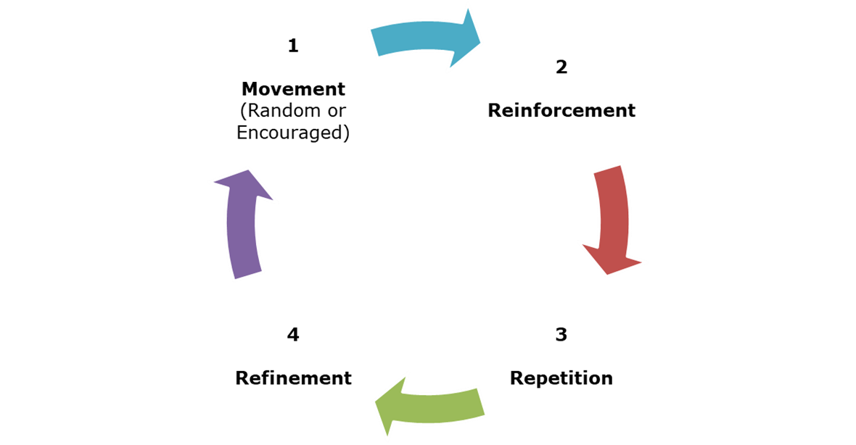
Operant Conditioning
MR 3 Cycle
Operant conditioning (or instrumental learning) refers to learning promoted by specific behavioral techniques.
Designed to promote and maintain learning, through response-contingent feedback.
Child utilizes a movement
You combine it with a reinforcement
It promotes the continuation of that movement

Slide 20
Targeted Goal
Choose Appropriate Activities
Model & Successive Prompt Movement Target
Promote Learning
Using Reinforcement
Progressing & Adapting Activities Appropriately
Promote Skill Maintenance & Generalization
Movement/Activity Repetition
Positive/ Successful Outcomes

Slide 21
Video of parent training and showing technique of I-ACQUIRE

Slide 22
What makes I-ACQUIRE Different from Traditional (PT/OT) Therapy?
Traditional Therapy
I-ACQUIRE
Less operationalized definitions of learning principles
Good Therapists do much of the same learning principle techniques in their treatment sessions
  Less opportunity to see progression
  Success becomes harder for both the child and the therapist across time
Focus on Learning Principles
Progression expected both within each session and across sessions
  Small Incremental Steps (as dictated by learning principles)
  Specificity of
    Prompts & Reinforcements
  Success oriented
Intensity
  There is Greater Number of Repetitions
  Affords Greater Opportunity for Refinement, Solidification (skill and neural representation), & Generalization

Slide 23
Assessment Core
Jill Heathcock PT, PhD – Associate Professor
Amy Darragh OTR/L, PhD – Associate Professor
Thais Cabral OT, PhD – Post Doctoral Fellow
The Ohio State University

Slide 24
Outcome measure
Emerging Behaviors Scale
  Bayley Scales of Infant Development (Bayley-III)
  Gross Motor Function Measure-66 (GMFM-66)
  Mini Assisting Hand Assessment (mini-AHA)
  Time points
    Pre-treatment, Post treatment 1 month, Post-treatment 6 months

Slide 25
Blinded Assessors
Complete the outcome measures
  Emerging Behaviors Scale – partial, confirmed centrally
  Bayley Scales of Infant Development (Bayley-III) – full, with modifications for R + L on FM subscale
  Gross Motor Function Measure-66 (GMFM-66) – full
  Mini Assisting Hand Assessment (mini-AHA) – administer the play session, scored centrally.
    All sessions are videotaped and transfer to the OSU
    IACQUIRE computer, tripod

Slide 26
Blinded Assessors
PT, OT, developmental psychology, psychologists, person with experience conducting evaluation with children
Preferably with age range or some assessment
*not the treating therapist or study coordinator* (maintain blinding is the goal)
Each site = 2 blinded assessors
Attend training, achieve and maintain >85% reliability on tools
  Prior Study (June)
  Web-based training with Assessment Core (July)
  Score videos for reliability
  Send back to assessment core a child/assessor interaction + score
    Administration and score (hemiparesis preferred)
  Yearly reliability checks to avoid and correct drift

Slide 27

Parent Outcome Measures

Slide 28
Parent Measures
Parent Report
Infant Motor Activity Log
MacArthur Bates Communicative Development Inventories (CDI-III)

Slide 29
I-MAL
Evaluates the infant’s frequency and quality of affected UE movement in everyday tasks.
Collected at Pre, Post, 6 mos
Parent rates how often (never-always) & how well (poor-normal) child uses affected-UE for 20 infant arm/hand tasks.
Sample items: Hold a bottle/cup, Eat finger foods, Pick up a cylindrical object (e.g., crayon, marker, bottle, cup, or rattle).

Slide 30
MacArthur Bates Communicative Development Inventories (CDI-III)
Assesses early language skills in infants & toddlers:
(Comprehension, Vocabulary, Grammatical Skills, Nonverbal Gestures and Actions )
Collected at Pre, Post, 6-mos
Available for Infants and Toddlers 8 – 30 months
Forms can be completed in 20 – 45 minutes
Parents can complete at home
Notes:
Available for Infants and Toddlers 8 – 30 months
Infant Form: Words and Gestures (8- to 18- months): assesses Phrases Understood, Words Understood, Words Produced, Early Gestures, Later Gestures, and Total Gestures
Toddler Form: Words and Sentences (16 – 30 months): assesses Words Produced, Irregular Words, and Mean Length of 3 Longest Sentences
Words Produced will be used for data analyses (Infant and Toddler forms both include so we can over time)

Slide 31
Parent Measures
Parent Experiences and Background
Demographics
Perceived Stress Scale plus stress schedule
Pre-treatment and Post-treatment Questionnaire
Report of Therapy Experiences
Report of Parent-Therapist Information Exchange
Physician Administered
Neurological Exam: Medical History and PSOM (pre-only)

Slide 32
Perceived Stress
Assesses perceptions of stress; specifically, the extent to which situations are perceived as stressful
Parent’s self-reported perceptions of stress are assessed at baseline, post-treatment 1-month, and at post-treatment 6-month.
Includes Perceived Stress Scale and Self-reported perceptions of stress
Parents can complete at home

Slide 33
Pre and Post-Questionnaire
General information about therapy and therapist

Slide 34
Parent Measures
Report of Therapy Experiences
Information about the therapies that the children in the study have participated in

Slide 35
Parent Measures
Physician Administered
Neurological Exam: Medical History and PSOM

Slide 36
Parent – Therapist Information Exchange
Assesses process of goal setting; preparation and training; role of parent in therapy
Completed by both parent and therapist post-treatment

